Slide 1
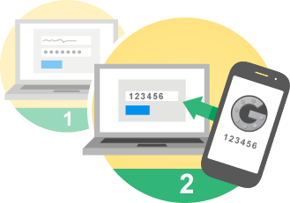
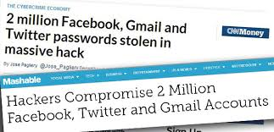
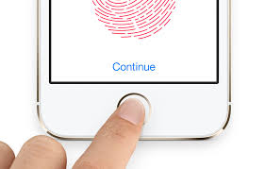
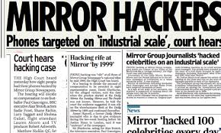
Idea One

Slide 2
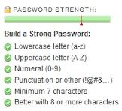

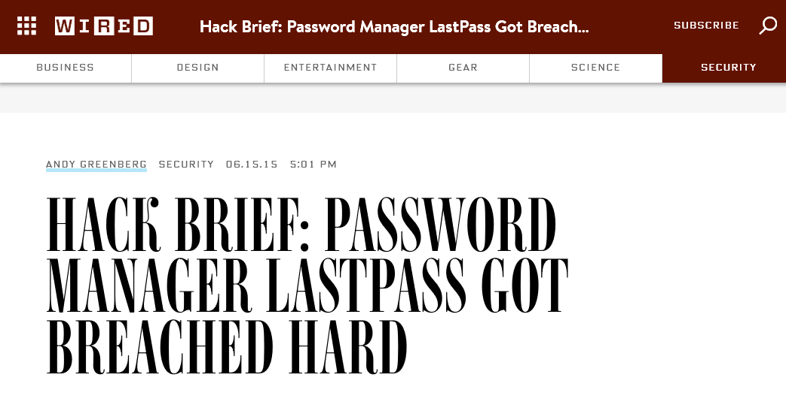
Idea Two

Slide 3
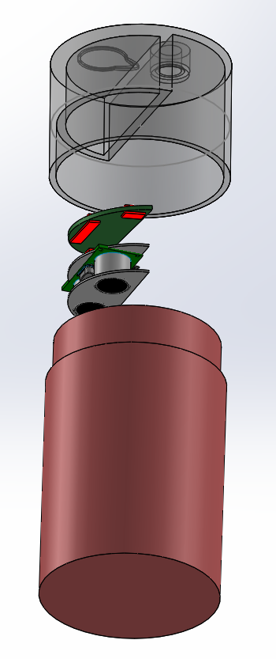
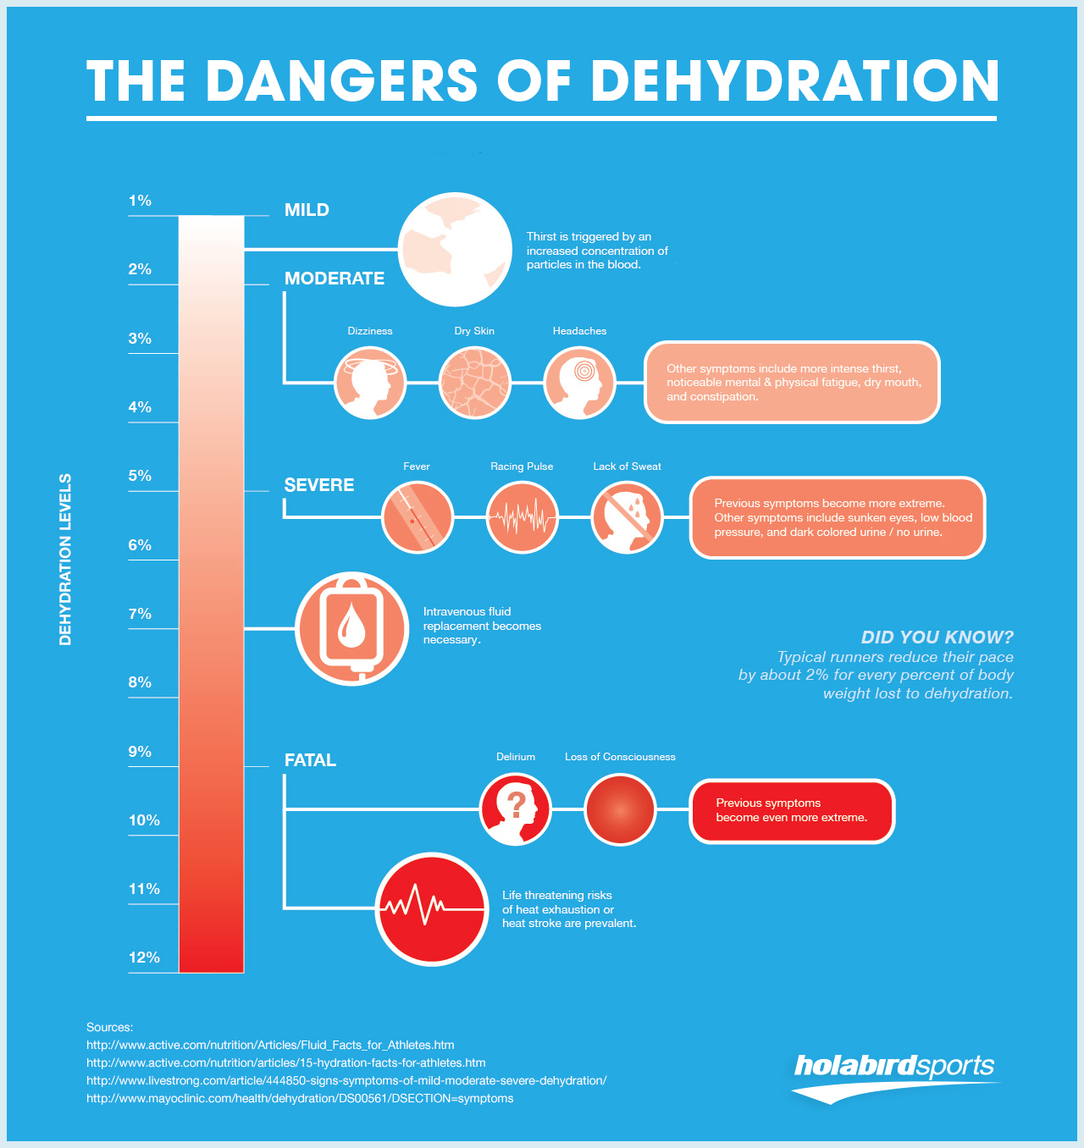
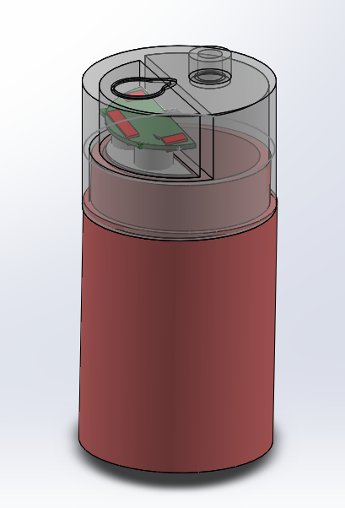
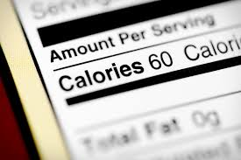
Idea Three

Slide 4
 | 2 Step authentication | Offline Password Manager | Smart Water Bottle
Interest | +++ | ++ | +
Complexity / Feasability | + | +++ | +
Uniqueness | +++ | + | -
Current Knowledge | + | ++ | ++
Degree Choice | +++ | +++ | ++

